Slide 1


Organ & Blood Donation Management System
By
Abdul Hakim
Ashok Reddy V
Bharath KS
BLOOD | ORGAN TRANSPLANTATION

Slide 2
Abstract
The objective of this application is to developing an Organ & Blood Donation Information.
The Donation Agent is to create an e-formation about the donor and organization that are related to donating the blood & organ.
This System is used for maintain whole information about donors & receivers.
User Friendly interface

Slide 3
Technologies Used
Hardware
Processor | INTEL i3
Hard Disk | 40 GB or more
RAM | 2GB or more
Software
Operating System | Windows
Language | Visual basic 6.0
Database | SQL Plus

Slide 4


Players
[ user ]
[ admin ]

Slide 5
Role of Players
[ User ]
Request Blood & Organ
Register Donors
Read & Write access to database
[ Admin ]
Add new user
Manage existing users
Manage donors
Full access to database

Slide 6
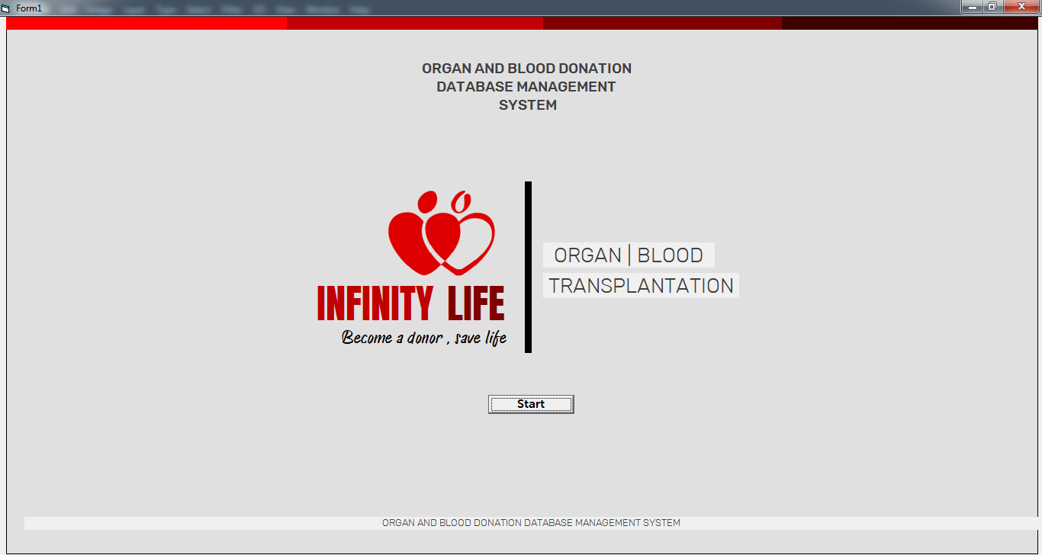
Startup / Loading Form

Slide 7
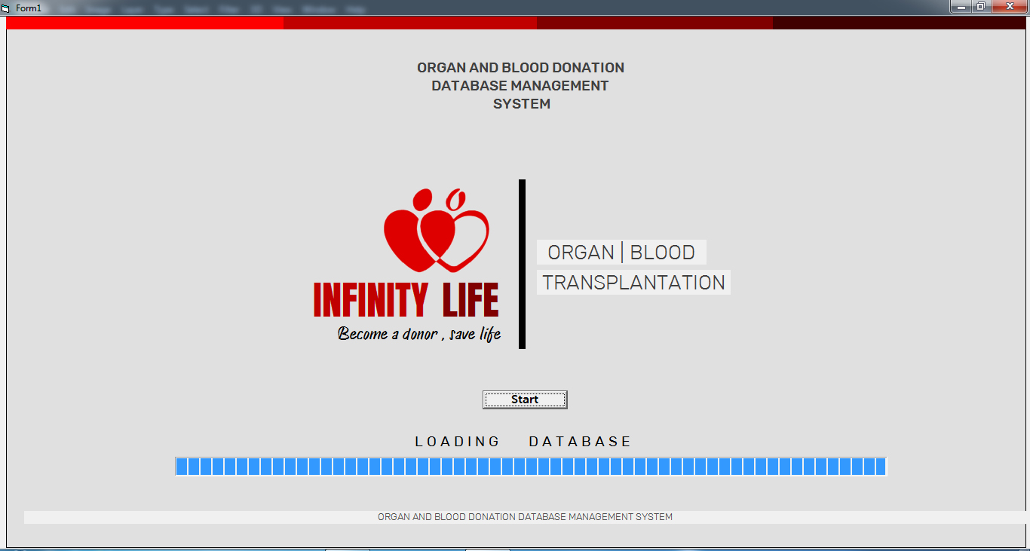
Startup / Loading Form

Slide 8
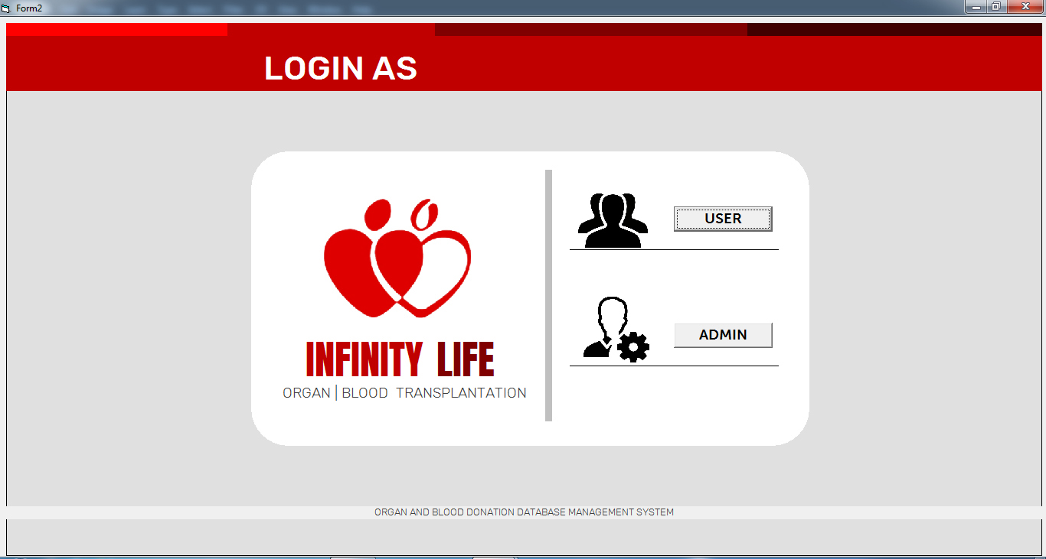
Login Form

Slide 9
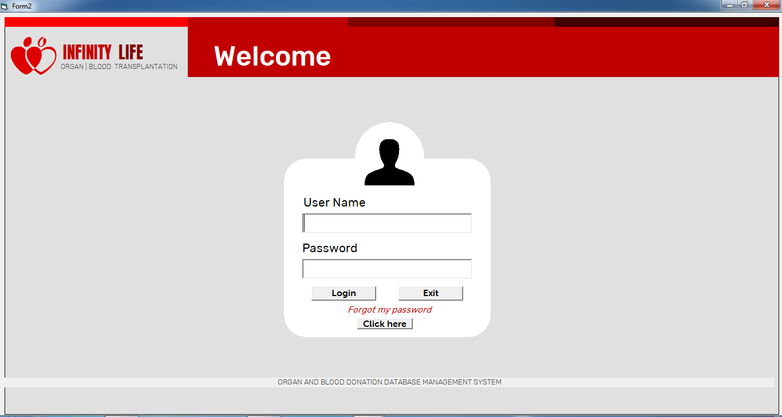
User Login Form

Slide 10
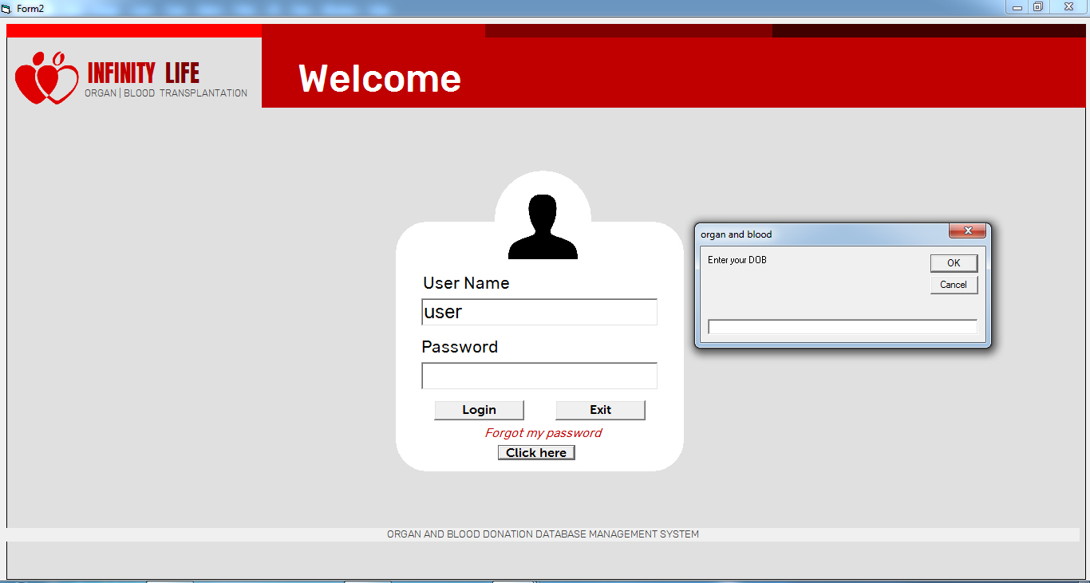
User Forgot Password

Slide 11
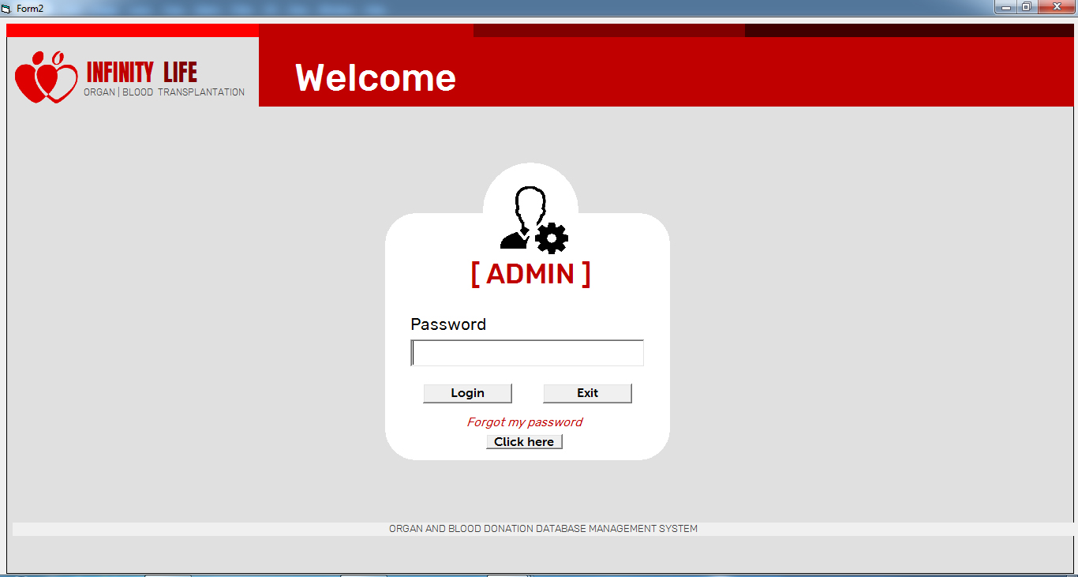
Admin Login Form

Slide 12
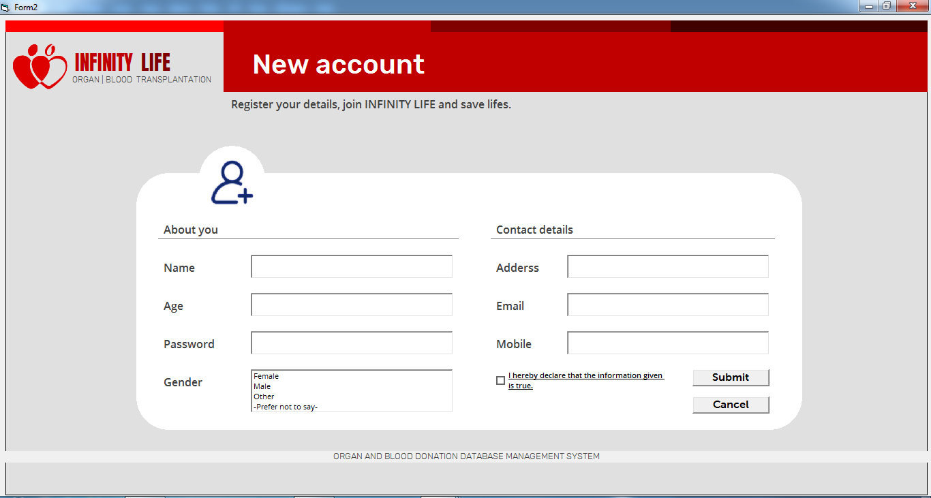
New User Account Creation Form

Slide 13
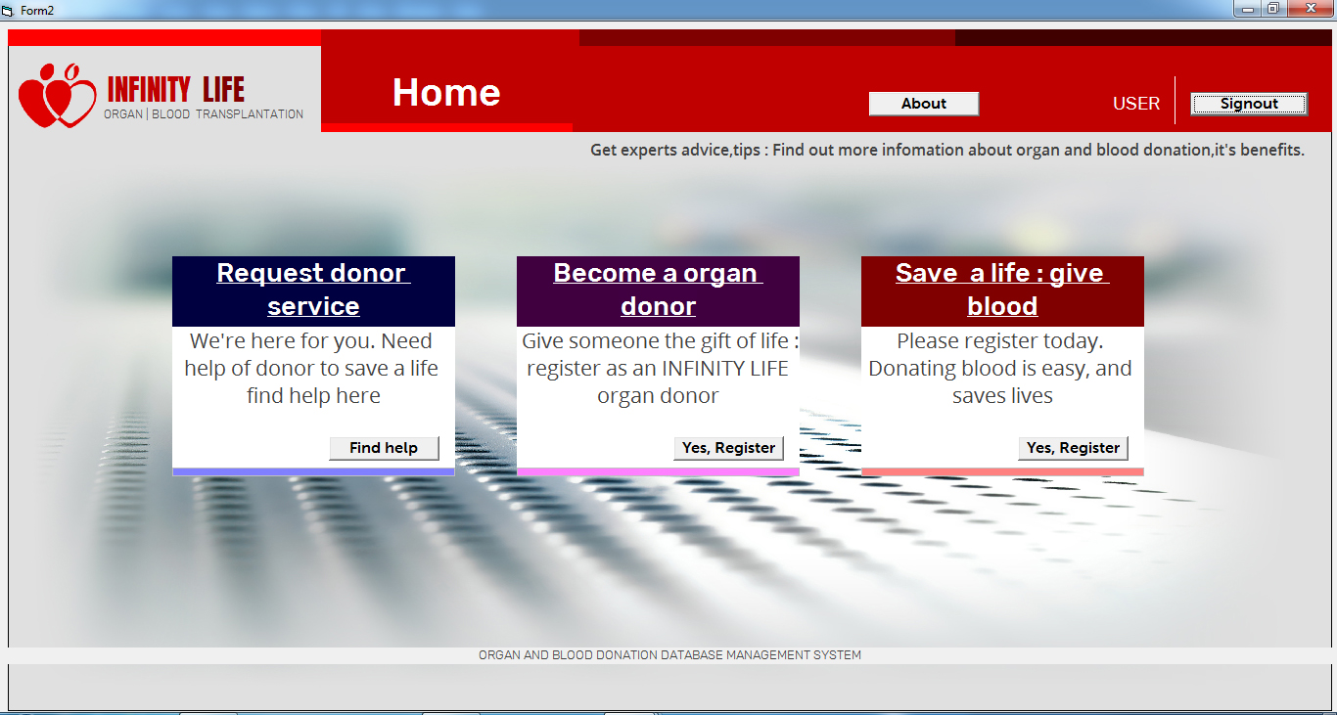
Home Page Form

Slide 14
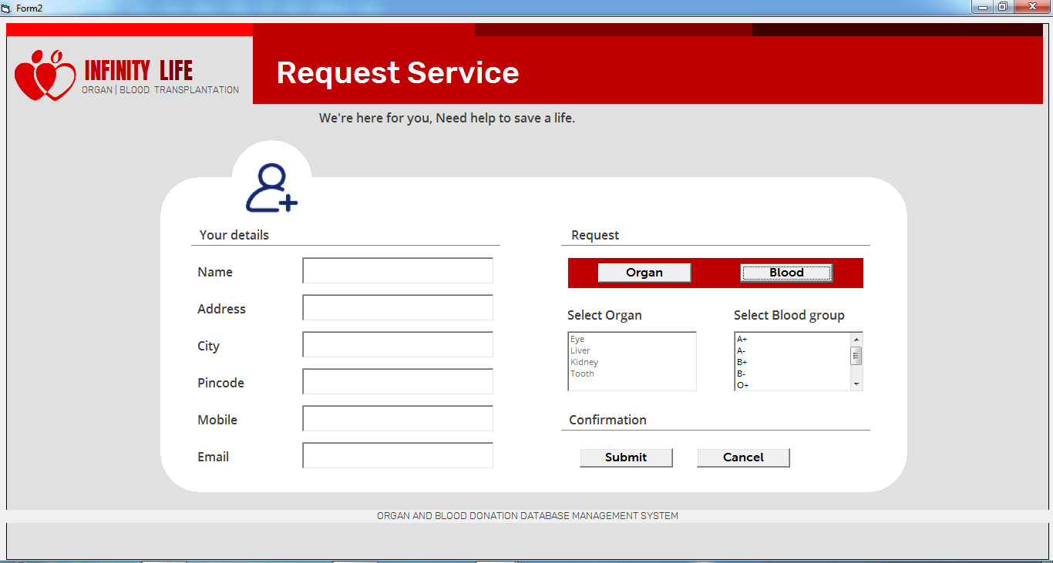
Request Form

Slide 15
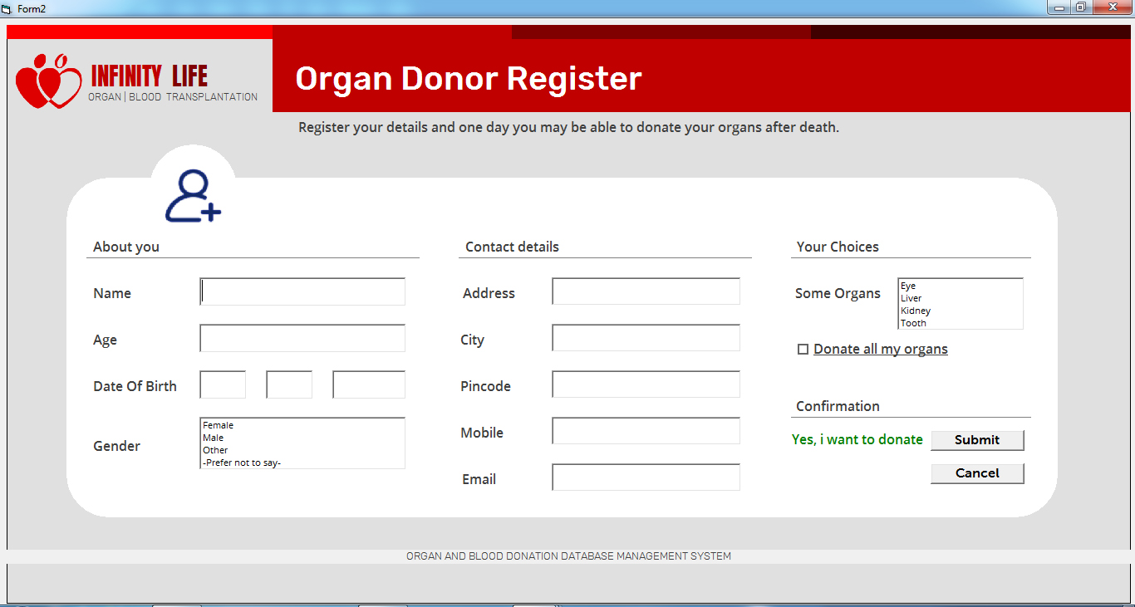
Organ Donor Register Form

Slide 16
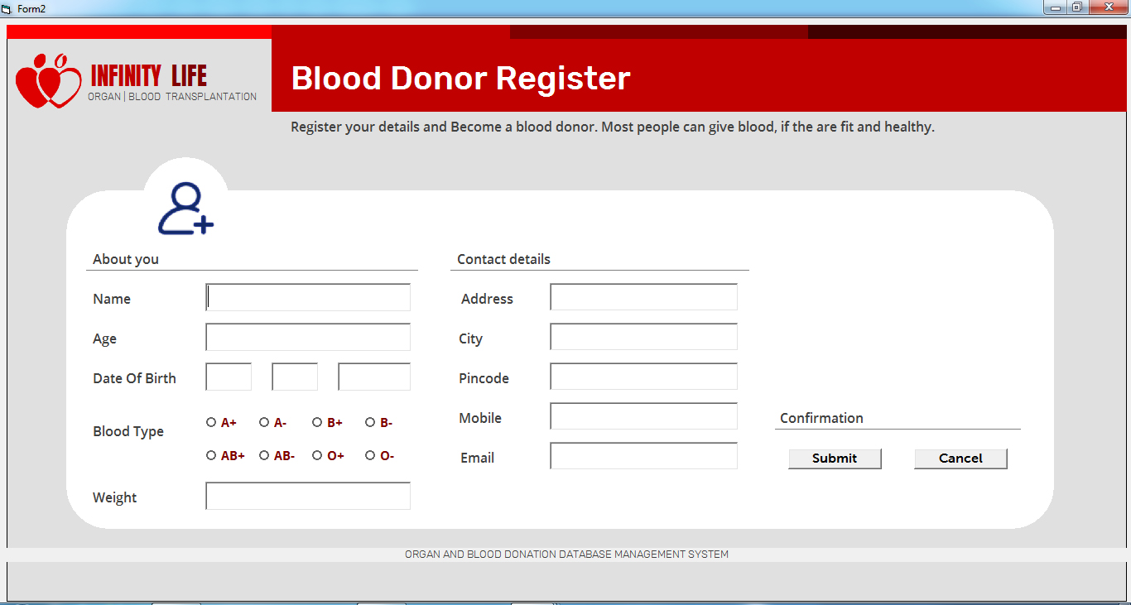
Blood Donor Register Form

Slide 17
Conclusion
Today the world is become a global village where every thing is online.
There are so many web based solutions provided in the market for the comfort of the people.
By donating Blood a person can save move than 2 lives.
By donating Organs after life (death) person can save more than 2 lives.
just by providing the digitalized solution of Organ & Blood Donation management information system is just one more step in order to serve the mankind.

Slide 18
Thank You
BLOOD | ORGAN TRANSPLANTATION

